Slide 1
Rainbow Cliques
Yoram Louzoun
Shoval frydman
Bar ilan university

Slide 2
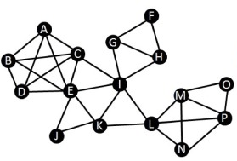
Problem Definition
Given a labeled graph (each vertex has a label), the goal is to find a group of vertices of size equal to the number of possible labels, where all vertices are connected to each other and have a different label.
This problem is equivalent to the problem of finding the maximum clique of the graph, with a constraint on the vertices in the clique to be each of different label.

Slide 3
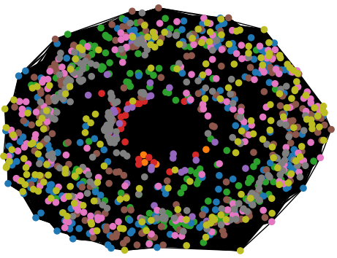
Initial Given Graph
The graph is undirected and defined as G=(V,E) where V is the set of vertices, |V|=1094, and E is the set of edges, |E|=472824.
Each vertex has a label, with a total of 9 different labels.
Vertices within the same group (i.e. vertices that share the same label) are not connected, and relations exist only between vertices of different groups.
The goal is to find the maximum clique (that according to the setting would be of size 9), where each vertex has a different label.

Slide 4
Solution 1 - Bron–Kerbosch Algorithm
Bron–Kerbosch algorithm is an enumeration recursive algorithm for finding all maximal cliques in an undirected graph.
Given G=(V,E), we apply BK algorithm on G and stop when the first required maximum clique is gotten.

Slide 5
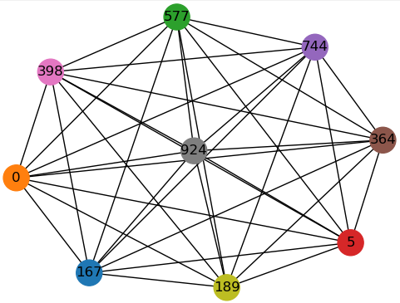
Solution 1 - Bron–Kerbosch Algorithm

Slide 6
Solution 2 – Greedy Algorithm
We start with the class that has the minimal number of vertices, and take all its vertices as seeds, i.e. each seed is an initial clique that is defined as a vertex at the beginning.
We apply GC(i) For each seed (initial clique) i: We remove from the graph the vertices that are not connected to it, take the vertex with the highest degree and add it to the clique. Then we do the same process to the new inserted vertex and continue in an iterative way until a maximum clique C_{max} is gotten (not necessarily with vertices of different classes as needed).
Given C_{max}, we take all the triplets within it, define seeds as (k,l,m) and run GC(k,l,m) to obtain C_{colorful_ max} which is the maximum clique where all vertices are from different classes (same as the former stage but here the initial seed is composed of three vertices and not one).

Slide 7
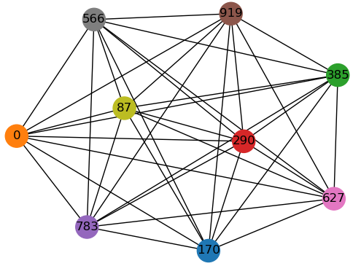
Solution 2 – Greedy Algorithm

Slide 8
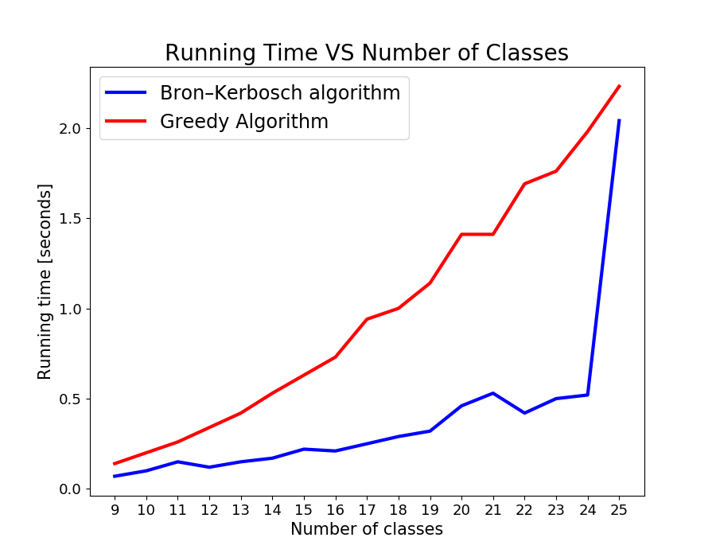
Running Time as Function of Number of Labels

